Slide 1
Friends of MIP
Coffee Talk
3/14/19

Slide 2
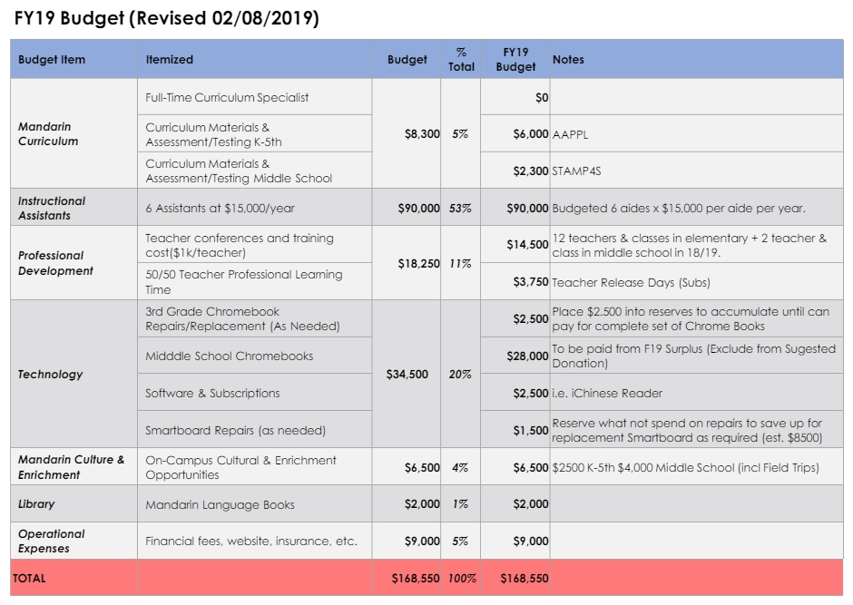
FY2019 Revised Budget

Slide 3
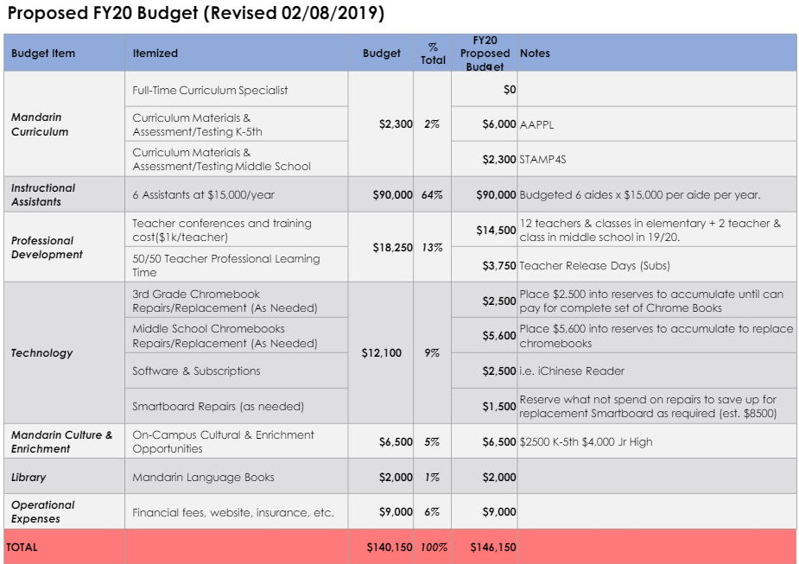
Proposed FY2020 Budget

Slide 4
Approved Funding for Newhart Middle School

Slide 5
New Suggested Donation
The suggested donation amount for the current fundraising period which runs from
November 2018 - October 2019:
$150/middle school student
$400/elementary school student
*based on 100% participation*

Slide 6
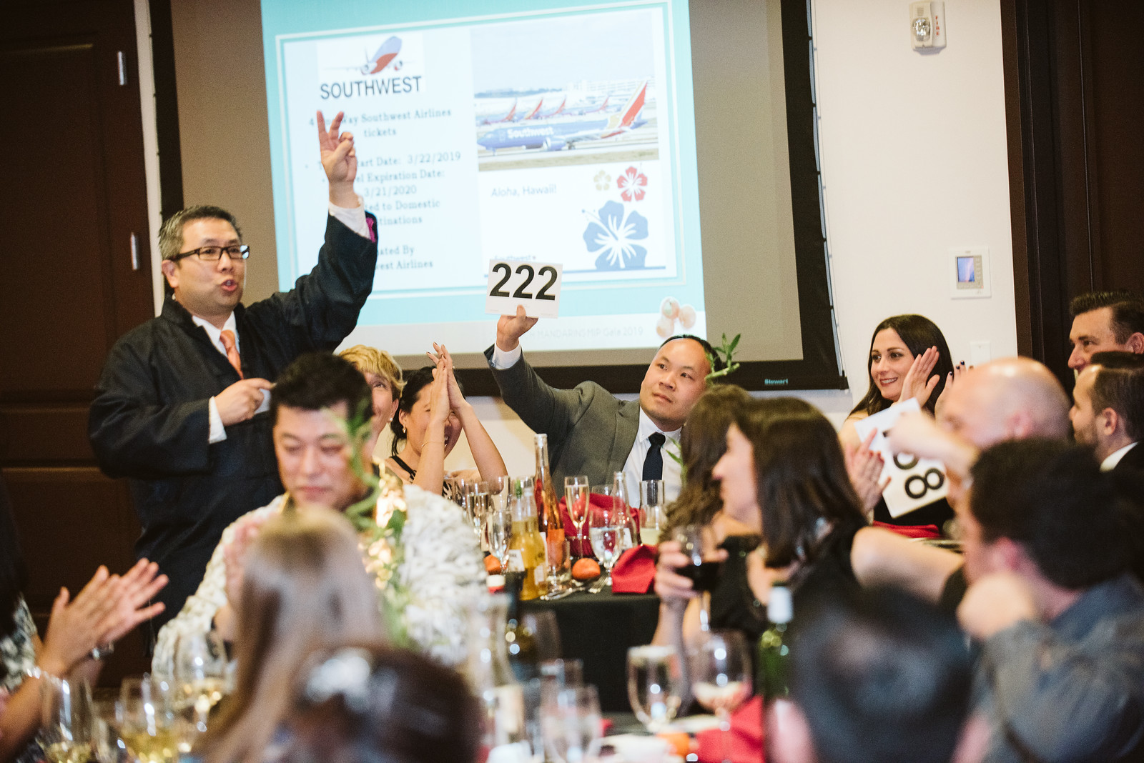
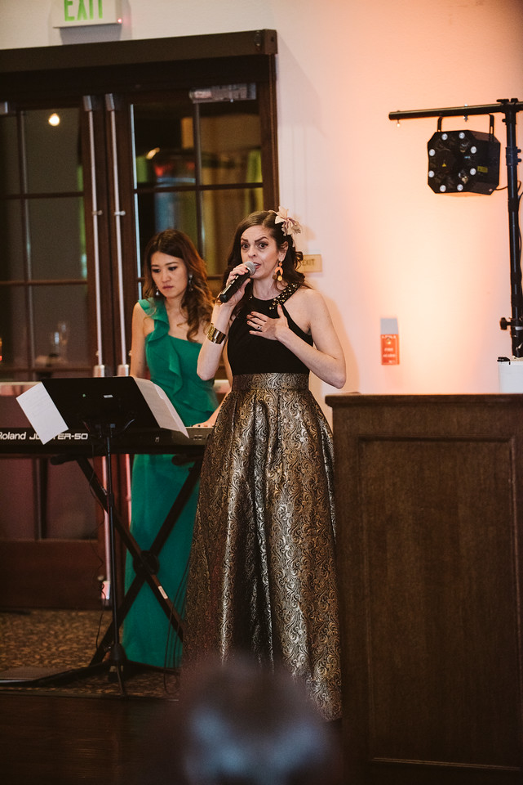
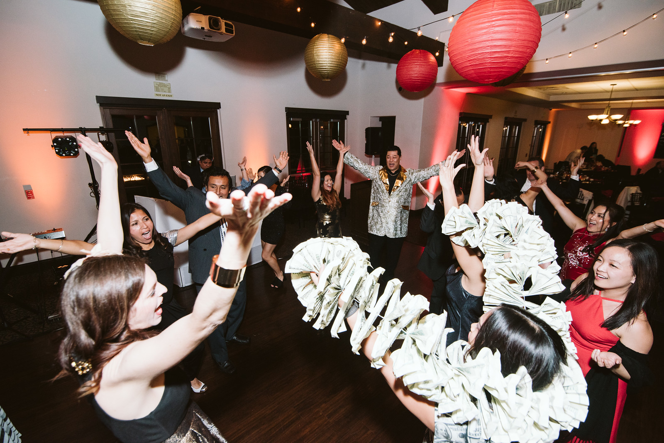
2019 MIP Gala
Took place on 2/23/19 at Aliso Viejo Center
130 Attendees including principals from all 3 school sites (Bergeson Elementary, Newhart Middle School and Capistrano Valley High School)
Teachers represented Kindergarten through 7th grade
Total fundraised $46,592.00
Net Proceeds after expenses: $31,342

Slide 7
Upcoming Outreach Events
Wed 3/27/19
Chinese Calligraphy sessions at Newhart Middle School
Fri 4/26/19
Bergeson Carnival - MIP will have bake sale and also Chinese Night Market Booths, will have signup genius volunteer slots
Thurs 5/23 4-7pm
End of School Year Social at CircusTrix OC

Slide 8
Meeting at Capistrano Valley High School
Tues 3/26
MIP High School Meeting
with Principal and IB Counselor
6pm - 7:30pm (new start time)
The Mall @ Capistrano Valley High School
Capistrano Valley High School (CVHS) Principal John Misustin and a CVHS academic IB counselor will meet with parents and answer questions regarding scheduling, IB and other high school related topics. Children are welcome.

Slide 9
2019-20 School Year MIP Board Elections
Letter of Interest Due 3/31/19
President
Vice President
Treasurer
Financial Controller
Secretary
Public Relations/Communications Director
Community Liaison
Outreach Director
Middle School Liaison (New)

Slide 10
Questions
Thank you for your time!

